Slide 1
A little bit about my team
~65,000
~800
~50
~8
3
engineers at Microsoft
on Azure DevOps team
feature teams
people per team (mix of PM & dev)
campuses

Slide 2

1ES
Time to market
Productivity
Agility
Job satisfaction
1st Party is 3rd Party

Slide 3
DevOps at Microsoft
This is the volume of activity generated by around 90,000 internal users
➔
https://aka.ms/DevOpsAtMicrosoft
372k
Pull Requests per month
4.4m
Builds per month
5m
Work items viewed per day
78,000
Deployments per day
2m
Git commits per month
500m Test executions per day
500k
Work items updated per day
Data: Internal Microsoft engineering system activity, August 2018

Slide 4
How does Azure DevOps deliver it’s services to customers?

Slide 5
https://dev.azure.com/your-org
Feed
Package
TFS
Code
Search
Each organization is serviced by many multi-tenant services.
SPS
Blob
AEX
Artifact
CodeLens

Slide 6
Scale Units
This is a scale unit. A scale unit is a deployment of a single service within an Azure data center.

Slide 7
Global Footprint
Each service has multiple scale units deployed around the world

Slide 8
Service Rings

Slide 9
Safe Deployment

Slide 10
https://dev.azure.com/your-org

Slide 11
Deployment trains
#AzureDevOps
Demo
Mitch Denny

Slide 12
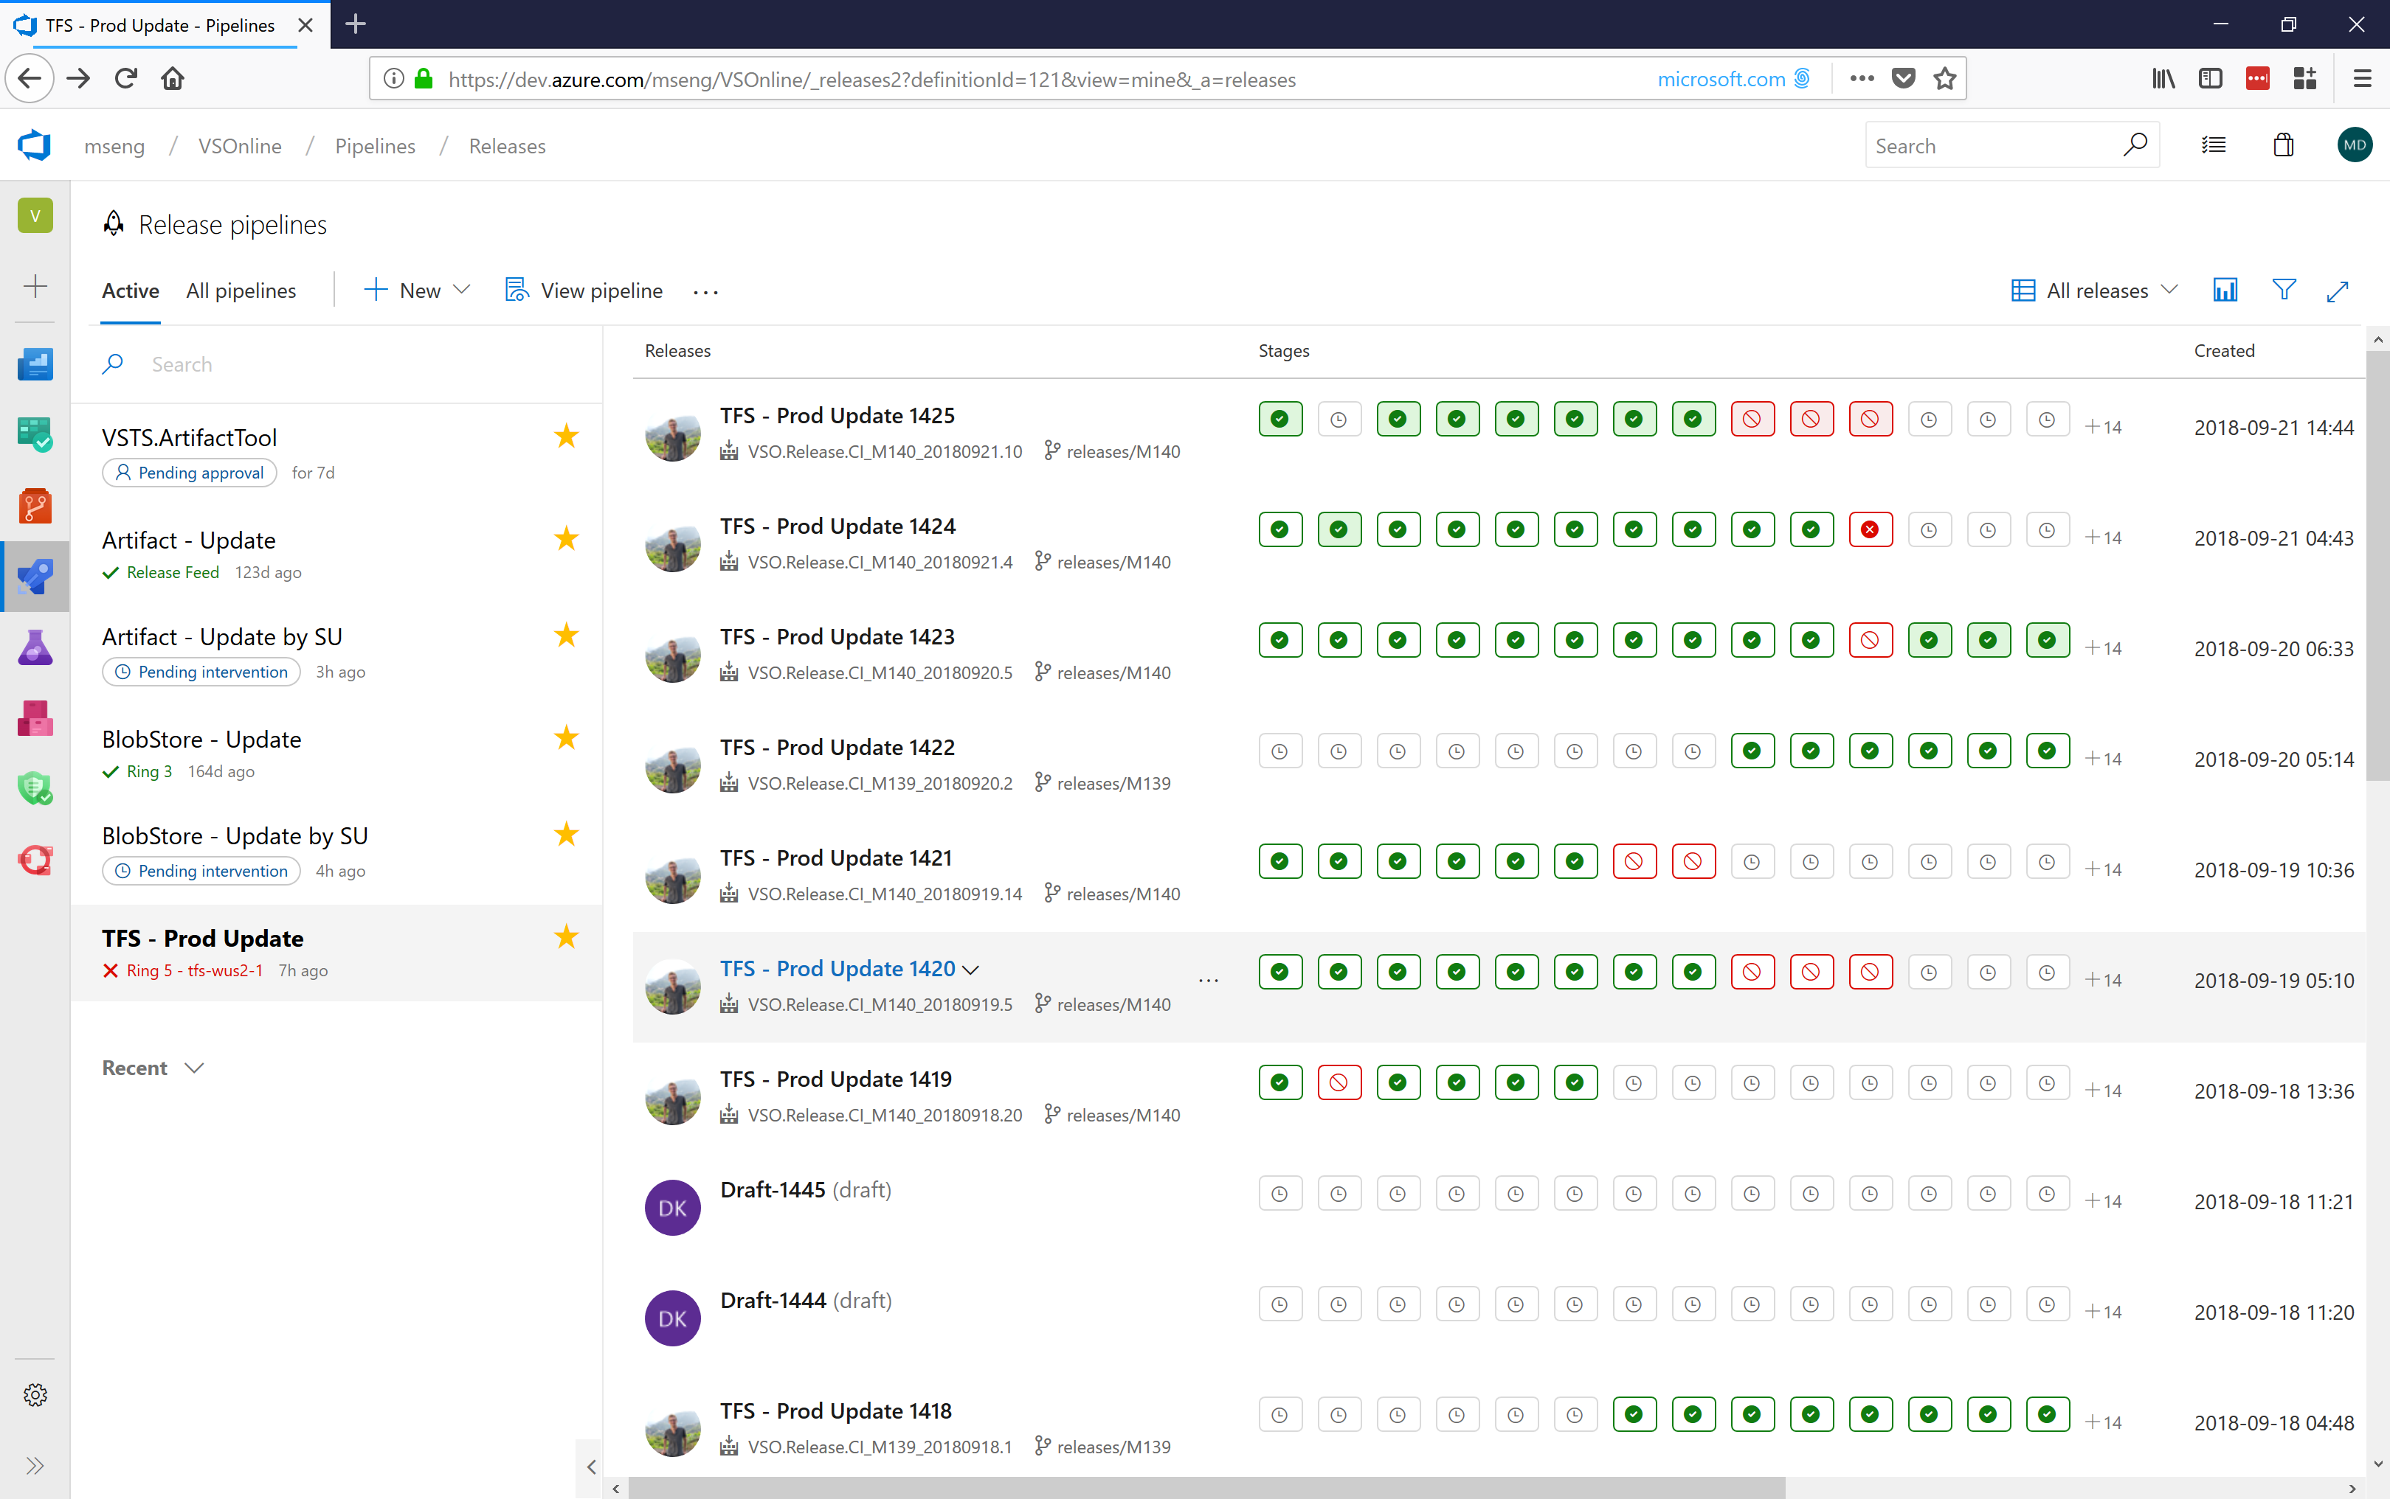

Slide 13
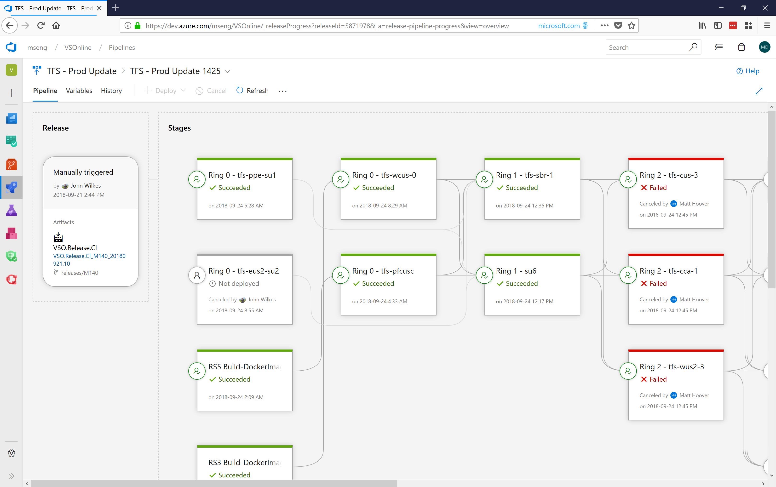

Slide 14
We deploy product increments every sprint and hotfixes daily (at least)

Slide 15
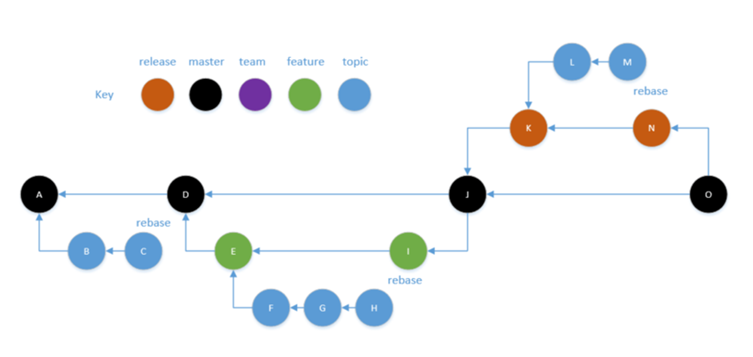
Our Git branching strategy on one slide
Everyone is on ONE main master branch
Git helps with lightweight topic branching
Tiny, continuous merging
Code is fresh in your mind

Slide 16
Pull requests and automation
#AzureDevOps
Demo
Mitch Denny

Slide 17
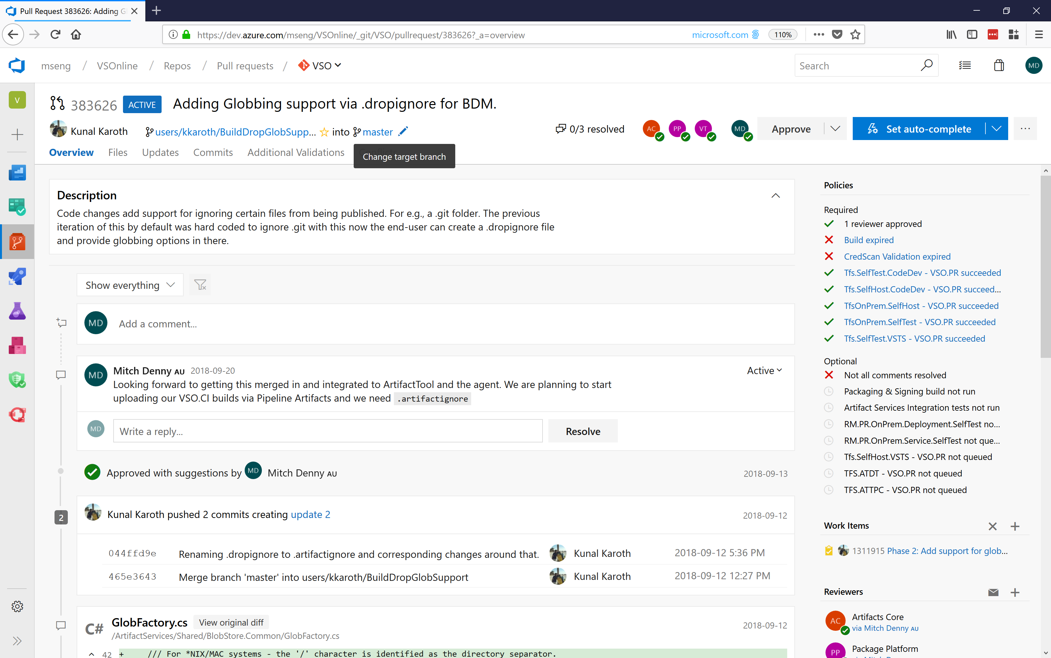

Slide 18
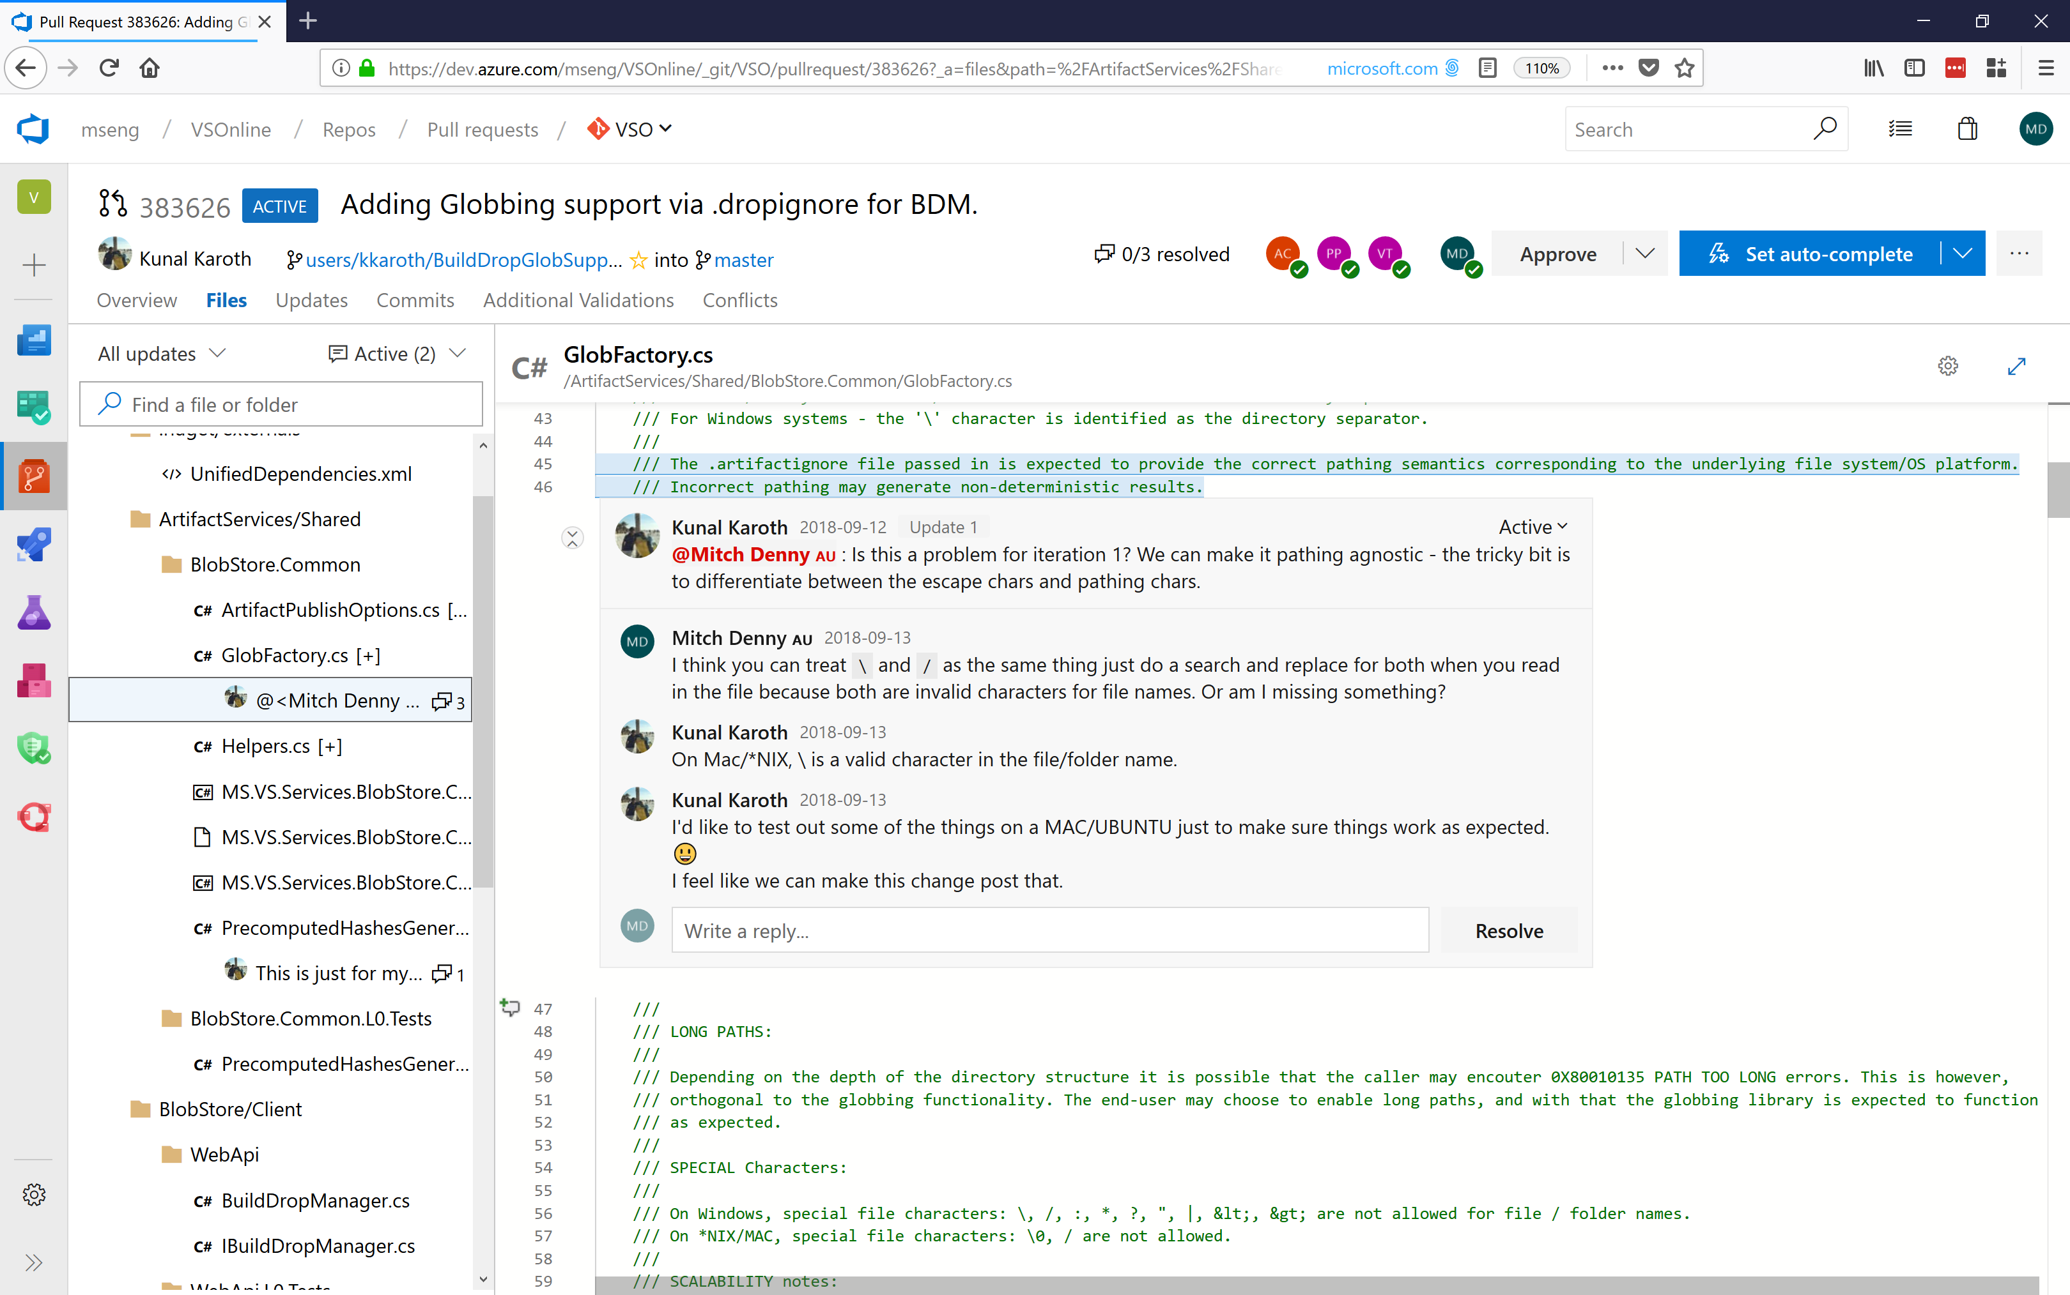

Slide 19
What about testing?

Slide 20
What about testing quality?

Slide 21
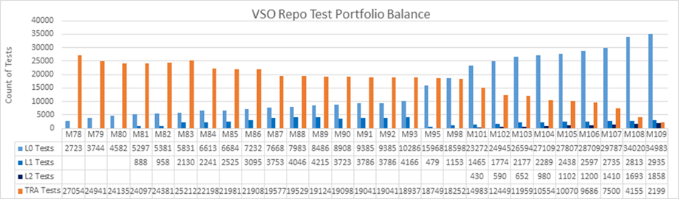
Optimize testing mix to reduce cycle time
Integration Tests
Unit Tests

Slide 22
Shifting left: integration testing on PR
#AzureDevOps
Demo
Mitch Denny

Slide 23
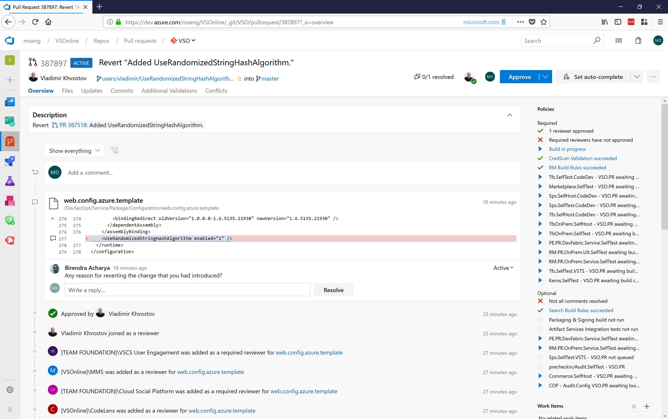

Slide 25
Managing work that spans multiple sprints

Slide 26
Feature flags to control exposure
#AzureDevOps
Demo
Mitch Denny

Slide 27
Quality of experience: using feature flags
Notes:
So… we decided that this wasn’t about the process. It was about the mechanics of our code base, and ensuring that our code base supported the way we wanted to work.

Slide 28
ON
Feature
Flag
OFF

Slide 29
ON
Feature
Flag
OFF

Slide 30
ON
Feature
Flag
OFF

Slide 31
ON
Feature
Flag
OFF

Slide 32
ON
Feature
Flag
OFF

Slide 34
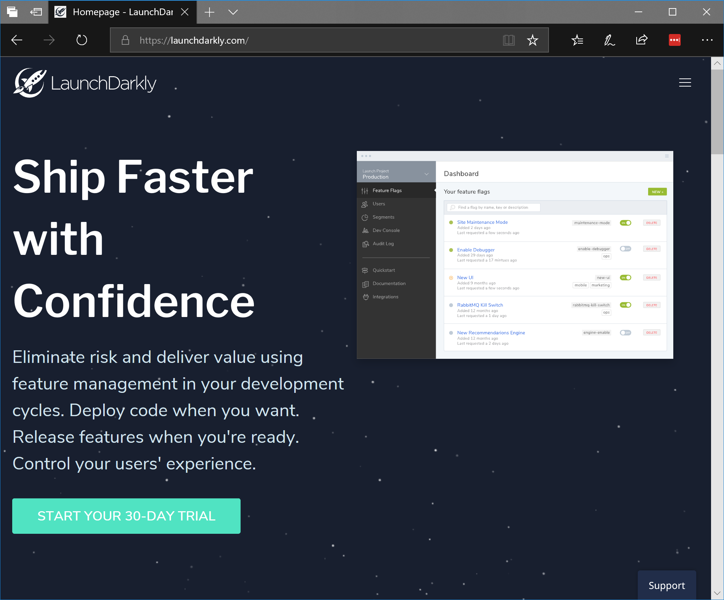

Slide 35
How do we know if we should keep a feature flag on or not?

Slide 36
Using telemetry to make decisions
#AzureDevOps
Demo
Mitch Denny

Slide 37
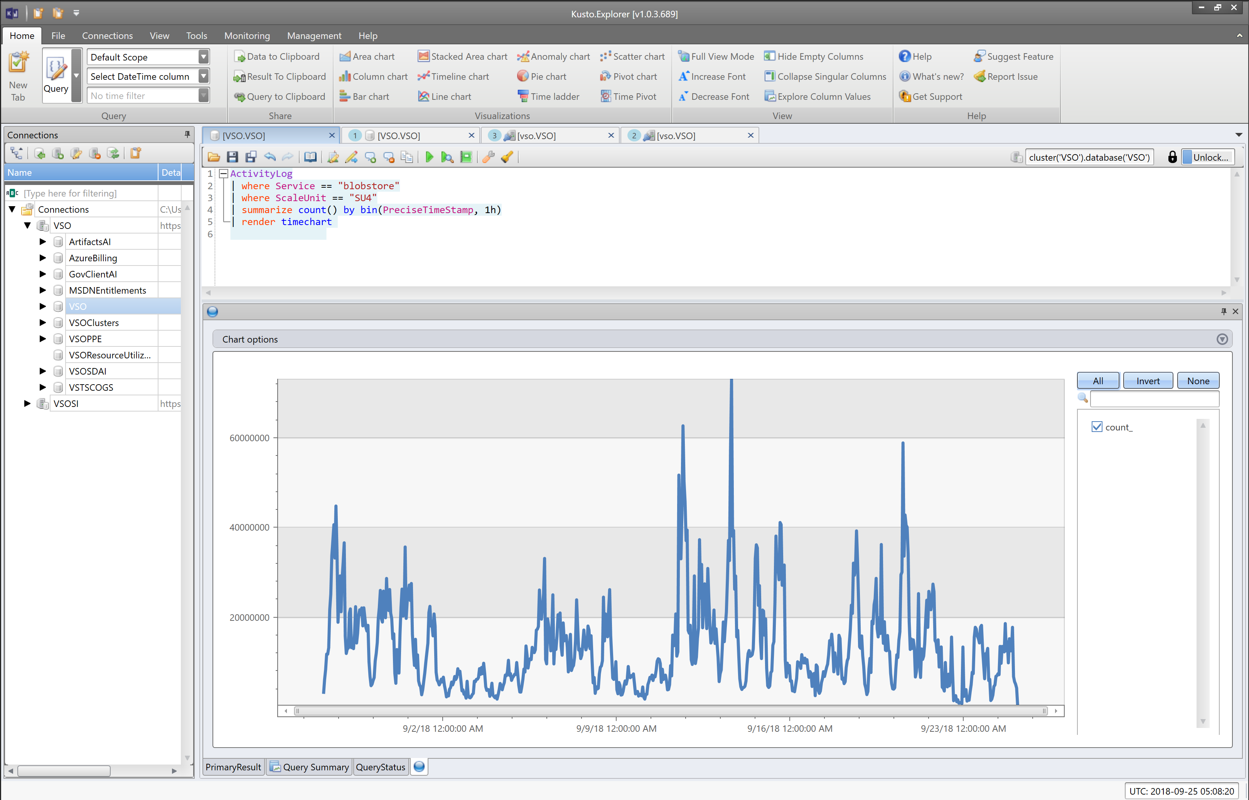

Slide 38
Using data to understand problems helps to inform the next problems we are going to solve.

Slide 39
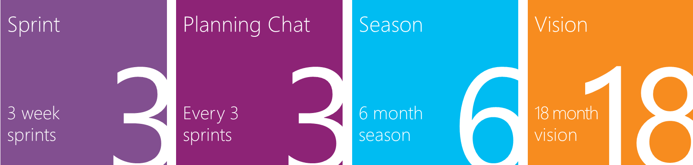
Planning Horizons

Slide 40
Live site and security are largely prioritized over everything else.

Slide 41

Security Mindset is Assume Breach
Use War Games to the learn attacks and practice response
vs.
 Double blind test
 Full disclosure at or near end
 Share tactics & lessons learned
 Continued evolution
https://www.youtube.com/watch?v=i9qf3VdfcjE

